Slide 1

Susanne Whitworth
Notes:
Everyone on mute. Questions in the chat box. If they are very specific or in depth we may suggest organising a separate one-to-one appointment to talk through your question.

Slide 2
The Energy Team
Our advice is free, impartial and confidential
Citizens Advice Diss & Thetford with Norfolk Citizens Advice
Team of six part time Energy Advisers
Help people with queries or problems with their energy supplier
Offer appointments over the telephone, email or face to face in one of our Citizens Advice offices

Slide 3
Energy Prices Rising
You may have noticed that energy prices have been rising.
Global prices for fossil fuels, especially gas, are increasing at an unprecedented rate.
From 1 April, the energy price cap will rise from £1,277 to £1,971 – an almost £700 increase in energy bills for the average household. The energy price cap is backstop protection from the government, calculated by Ofgem. It applies if you are on a default tariff (not on a fixed term tariff or standard variable green energy tariff that has been exempted from the cap.) If your fixed term tariff ends you are likely to find even higher increases.
This doesn’t impact on customers on a fixed tariff, but renewing a fixed tariff will increase similarly.

Slide 4
Latest news on government support
Energy bills rebate (by household) - £200 off in Autumn 2022 to be repaid over 5 years starting in 2023. Not specific to a person – by bill. Cannot opt out.
£150 non-repayable council tax rebate for bands A-D in England. (Also available if you don’t currently pay council tax for example for students.)

Slide 5
Energy companies going bust
If your energy company goes bust
You’ll still have gas and electricity if your energy supplier goes out of business
Take meter readings and a screen shot of any credit on the account
The gas and electricity regulator, Ofgem, will move you to a new supplier. This usually takes a few weeks.
Don’t switch tariff or supplier until your account is moved to the new supplier. You might find it harder to get any money you’re owed if you switch before this happens.
If your account is in credit your money is protected, unless you’re a small business customer. Your new supplier will tell you how you’ll be paid back.

Slide 6
Tariffs and Switching
Standard, fixed, Economy 7, Economy 10
Direct debit, pay on receipt of bill, pre-payment, fuel direct (debt repayment through benefits)
Search online ‘Citizens Advice Compare Energy’ for an impartial comparison tool.
You can switch if you have up to £500 debt on each fuel if you have a pre-payment meter (your debt will transfer to the new supplier.) Otherwise you cannot switch until your energy debt has been repaid.
Notes:
Facilitator notes
If you are in debt to your current supplier it is possible that they can stop you from switching until you have paid off your debt.
If a client is in debt they should seek further help - contact the Citizens Advice Consumer Service or visit their local Citizens Advice or advice centre
If you have a prepayment meter you can change supplier if you owe less than £500 for each fuel (gas and electricity). Your debt will transfer with you but you may benefit from a lower price which could help you pay it off faster.
If you don’t have a prepayment meter and have an outstanding debt your supplier has the right to prevent you leaving. They can’t stop you leaving if it is their fault you are in debt, for example, if they billed you incorrectly.

Slide 7
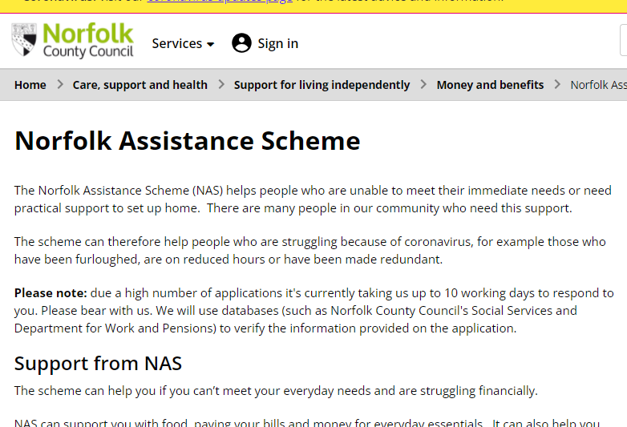
Struggling to pay your bills
Norfolk Assistance Scheme (inc debts)
If you have a prepayment meter and
you are in hardship there are a number
of schemes we can help you apply to

Slide 8
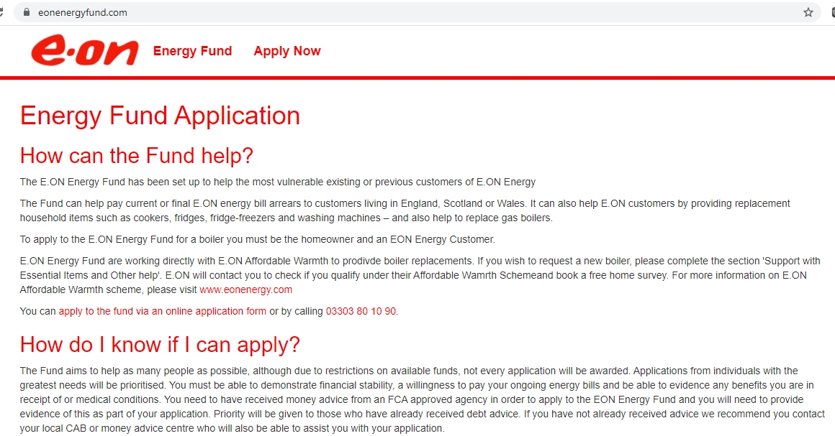
Struggling to pay your bills
Grants to help pay off your energy debts
If you’re in debt to your energy supplier, you might be able to get a grant to help pay it off.
Some energy suppliers offer grants to their customers:
British Gas Energy Trust
Scottish Power Hardship Fund
Ovo Energy Fund
E.ON Energy Fund
E.ON Next Energy Fund
EDF Energy Customer Support Fund
Octopus – Octo Assist Fund
If you can’t get a grant from your supplier,
check if you can get a grant from the British Gas Energy Trust. These grants are available to anyone - you don’t have to be a British Gas customer.

Slide 9
Struggling to pay your bills
If you’re struggling to afford your gas and electricity bills, contact your supplier to discuss ways to pay what you owe them.
Your supplier has to help you come to a solution. You should try to negotiate a deal that works for both of you.
If you don’t try to negotiate with your supplier, they might threaten to disconnect your supply.

Slide 10
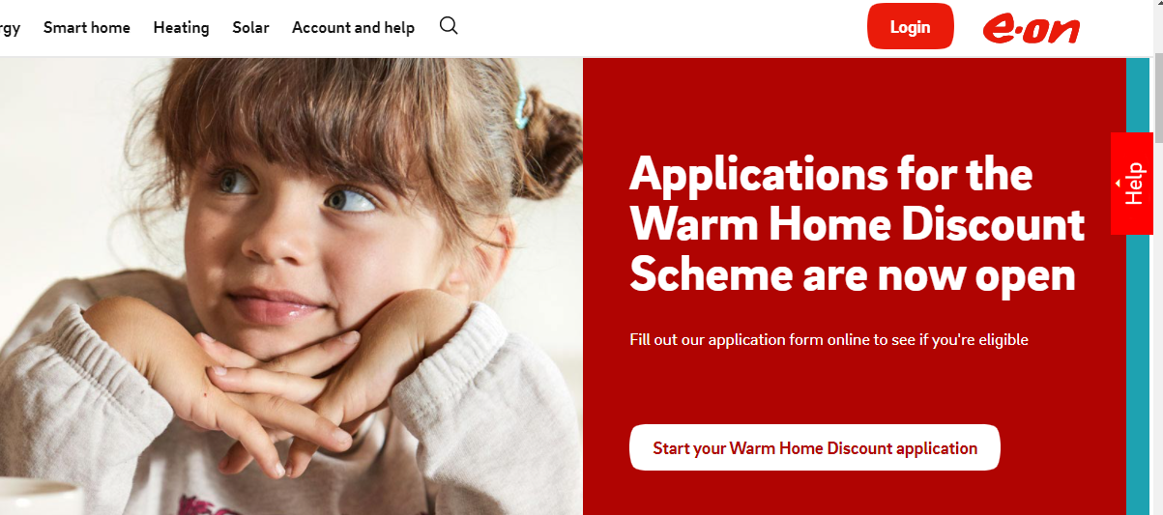
Government Help
You might be able to get £140 off your electricity bill or a £140 voucher for your prepayment meter. You can get this under the Warm Home Discount Scheme if you’re either:
getting the guarantee credit part of Pension Credit
on a low income
Most schemes closed for this year.
Winter fuel payments to households
where at least member is of pensionable age. £200 or £300 or over 80s.

Slide 11
Priority services register
If you find it hard to deal with your energy supply you could get extra help from your energy companies - for example, large print bills, nominating someone else to deal with your supplier or more support during a power cut.
You can join if you:
are of pensionable age
are disabled or chronically sick
have a long-term medical condition
have a hearing or visual impairment
have additional communication needs
are in a vulnerable situation
Priority support in an emergency. Could provide heating and cooking facilities if you are cut off supply.
Identification and password scheme. This could include arranging a password or agreed on picture cards if callers need to visit or contact you. This way you can feel confident they are genuine.
Nominee scheme. You can nominate someone to receive communications and bills from your supplier. For example, a family member, carer or someone you trust.
Help with prepayment meter access. For example, moving a meter if you can’t safely get to it to top up.
Regular meter reading services. For example, if nobody can read your meter.
Accessible information. For example, account info and bills in large print or braille.
Suppliers and could offer other support services. Ask them how they can help you.
Advance notice of planned power cuts. If you rely on your energy supply for medical reasons your network operator can tell you about planned power cuts. For example, when they plan engineering work.

Slide 12
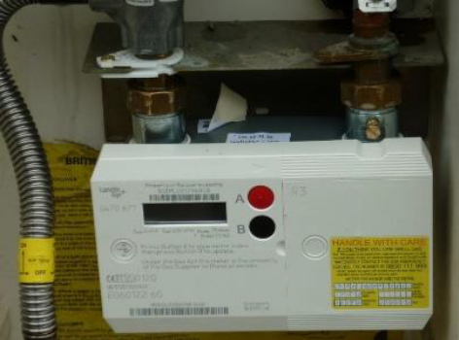
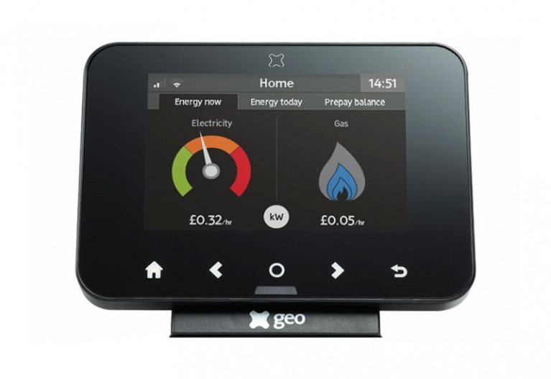
Smart meters
A smart meter could make it easier to manage your energy bills and see how your household is using electricity.
A smart meter can automatically send meter readings to your supplier, meaning they can bill you accurately for the energy you’ve used. This helps prevent large shock bills if meter readings are not submitted regularly.
You won’t have to pay upfront to have a smart meter installed
The In Home Display (IHD) shows you how much energy you are using and if you look at it through the day helps you understand how much energy each appliance is using.

Slide 13
Norfolk Warm Homes (run by Norfolk Council)
Grants for energy efficiency improvements to property.
Home-owners – help with up to £10,000 of energy efficiency improvements for families with household income under £30,000
Landlords – can receive a two thirds subsidy of up to £5000.
They won’t fund gas boilers (as fossil fuel – not renewable energy)
Can help with first time central heating grants, insulation and possibly air source heat pumps if the home is suitable.
If you are in social housing then your landlord (council or housing association) are responsible for energy efficiency improvements. If you are making requests to your landlord it will help if you reference your EPC.

Slide 14
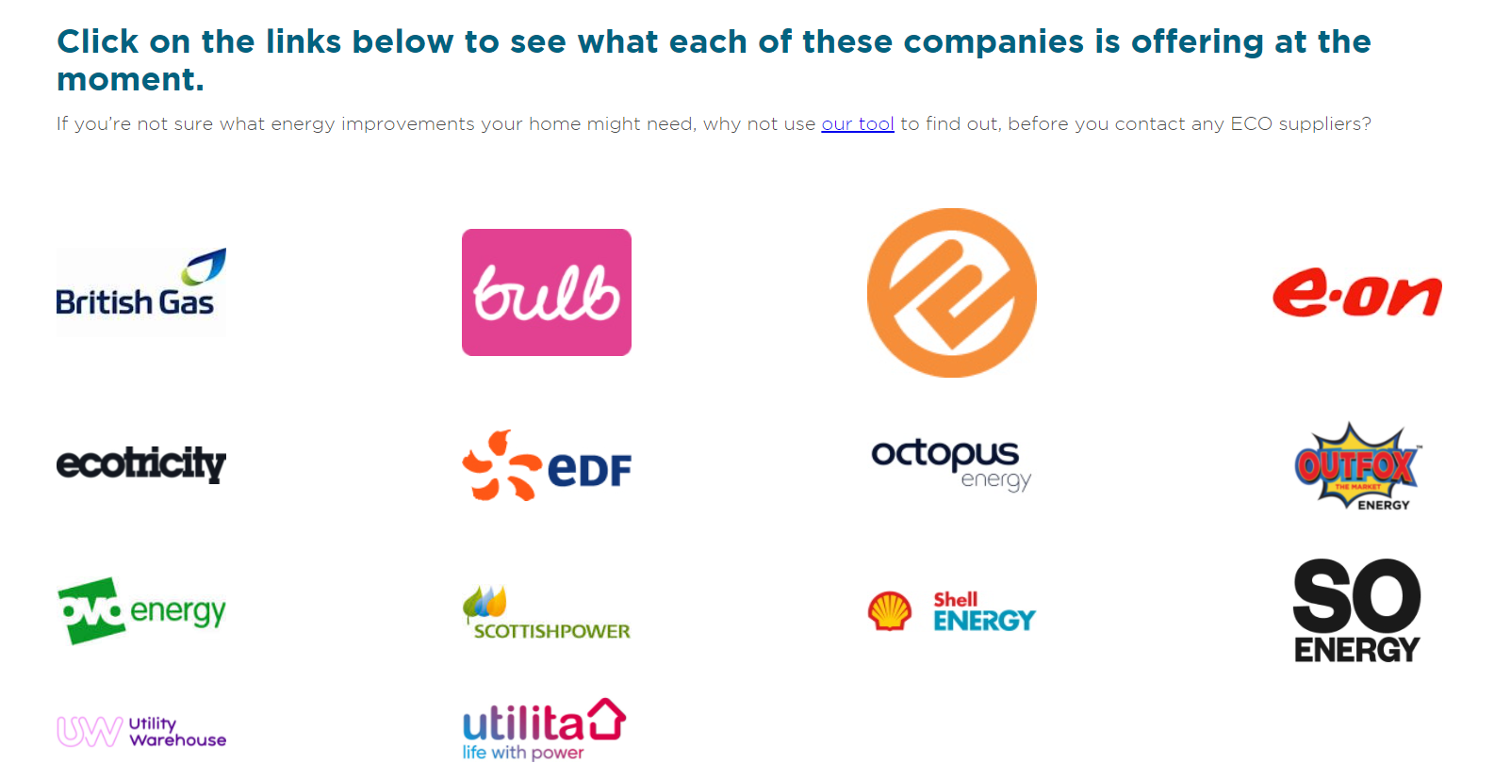
Energy efficiency and Energy Company Obligation ECO
Check what improvements you can make and grants you could get from the Energy company obligation (ECO) https://www.simpleenergyadvice.org.uk/pages/energy-company-obligation
Gives grants for efficient boilers and wall and cavity insulation
Available to people receiving certain benefits

Slide 15

Energy efficiency
You might be able to save money by making your home more energy efficient – for example by:
using your central heating effectively (check the manual)
keeping your home warm for longer
making changes so you use less electricity and gas
Make improvements to your home
You might be able to reduce your bills, for example by adding insulation or installing a better heating system.
You might be able to get a home energy grant to help pay for the improvements.
Find the Energy Performance Certificate (EPC) for your property https://www.gov.uk/find-energy-certificate

Slide 16
Tips for saving energy
Set heating and hot water to run only when it’s needed - for example, from 30 minutes before getting up in the morning to 30 minutes before leaving the house.
Set thermostats on hot water tanks to 60ºC or 140ºF - the thermostat is about a quarter to a third of the way up a hot water cylinder.
Close curtains - do this at dusk to stop heat escaping through the windows.
Block draughts using simple DIY materials - check for draughts around windows and doors that let cold air in and warm air out. About 25% of heat is lost through windows and doors.
Turn lights off when leaving a room and don’t leave appliances on standby - also remember not to leave laptops and mobile phones to charge unnecessarily.

Slide 17
Tips for saving energy
Fill up the washing machine, tumble dryer or dishwasher - one full load uses less energy than two half loads.
Don’t fill up the kettle - only boil as much water as you need.
Fix leaking taps and make sure they’re fully turned off - a dripping hot water tap can waste enough energy in a single week to half fill a bath with hot water.
Be careful of electric showers and other electric water heaters – these tend to use more energy.
LED lightbulbs – when you need to replace your lightbulbs switch to LEDS

Slide 18
Contact details
Feedback form – helps us with funding for future events
https://docs.google.com/forms/d/e/1FAIpQLSdGBS5Xfyw7a0mYuujyg-JEkkVSTno6fZ4H77howviUILpg_w/viewform?usp=sf_link
Organisation: Norfolk Citizens Advice
For a free thermometer email your home address to us at energyadvice@cadat.org.uk.
If you would like a one-to-one energy advice appointment contact:
energyadvice@cadat.org.uk
Tel 0800 144 8848
The Norfolk Warm & Wise project is a partnership between Citizen Advice Diss, Thetford and District and Norfolk Citizens Advice.

